Slide 1
CS151
Pointers
Notes:
For the 5th Edition of the book, you will want to look at chapter 12.1 and 12.2. We will get to chapter 12.3 shortly. For the 6th -8th editions, you want to look at chapter 9.1

Slide 2
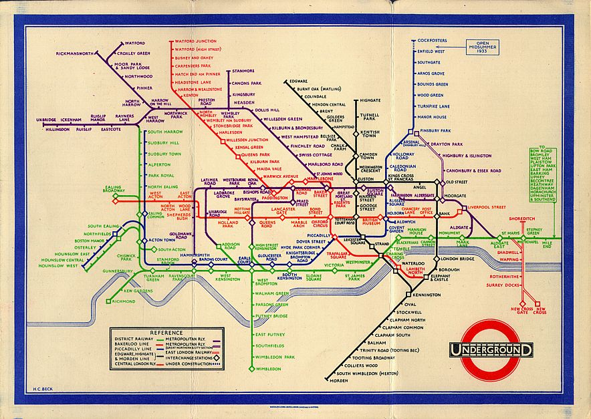
Pointers Philosophically
“Do not mistake the pointing finger for the moon” – Zen Saying
A map of a place is not the place itself, it is just a representation of the place
Notes:
The map on this slide is Beck’s map of the London Underground. This map represents how the stations are connected topologically without the need for distance, so here the map is truly not the place itself.

Slide 3
What is a pointer?
A pointer is the memory address of a variable
  A computer’s memory is divided into bytes
  A pointer indicates the address where the variable is held in memory (e.g. 1007)
1st Thought: This seems a bit strange
2nd Thought: You have already used pointers (call by reference parameters)
Notes:
You’ve also seen references to individual memory locations when we worked with arrays.

Slide 4
Declaring Pointers
A pointer can be stored in a variable
  However, you can not store a pointer in a variable of type int or double
A variable to hold a pointer must have a pointer type
  e.g. double *p;
  Declares a pointer p that can hold pointers to type double
Each variable type requires a different pointer type
Just place an asterisk at the beginning of the variable name
Notes:
For a bit of healthy insanity, read the green box regarding addresses and numbers on page 496 of Savitch – 8th Edition (page 502 – 7th Edition). I think it’s page 618 in the 5th Edition.

Slide 5
What do you think this does?
int *p1, *p2, v1, v2;
Answer: It defines two integer pointers named p1 and p2 along with two ordinary integer variables called v1 and v2.
Notes:
Answer: This creates integer pointers named p1 and p2. v1 and v2 are ordinary integer variables.

Slide 6
The & and * Operators
You can use the & operator to determine the address of a variable
  a.k.a. the address-of-operator
You can then assign that address to a pointer variable
  e.g. p1 = &v1;
You can now call v1 either v1 or *p1
  When used this way, the * operator is called the dereferencing operator
Notes:
You can also output the address and do some other operations with it, but we’ll save that for the lab.

Slide 7
What do you think will be the output?
v1 = 0;
p1 = &v1;
*p1 = 42;
cout << v1 << endl;
cout << *p1 << endl;
The answer to life, the universe, and everything else.
42
42
Notes:
Answer: 42 followed by a line break and 42.

Slide 8
Pointers in Assignment Statements
You can use the assignment statement to assign one pointer to another
  p2 = p1
This is not the same as *p1=*p2, which changes the variables that the pointers are pointing to
Figure 9.1 in Savitch explains this very well
Notes:
If you have the 5th Edition, look at Figure 12.1 The second bullet just says the values are equal, but the pointers are still pointing at two separate things. See the following slide.

Slide 9
What happens with equality?
p1 = p2
p1
84
p1
84
p2
99
p2
99
*p1 = *p2
p1
84
p1
99
p2
99
p2
99

Slide 10
Dynamic Variables
Using pointers, variables can be manipulated
even if there is no identifier (name) for them
  To create a pointer to a new "nameless" variable of
  type int:
  p1 = new int;
  The new variable is referred to as *p1
  *p1 can be used anyplace an integer variable can
  cin >> *p1;
  *p1 = *p1 + 7;
  The new operator produces a new nameless variable
  These are called dynamic variables
Notes:
The new operator creates a new dynamic variable of the specified type and returns a pointer that points to this new variable.
Dynamic variables are variables that are created at runtime.

Slide 11
Basic Pointer Manipulations
It’s important to be able to follow basic pointer manipulations so that you can see what different types of assignments do.
We’ll get a chance to work with these concepts in the lab.

Slide 12

The Free Store
An area of memory called the freestore is
reserved for dynamic variables
  New dynamic variables use memory in the freestore
  If all of the freestore is used, calls to new will fail
Unneeded memory can be recycled
  When variables are no longer needed, they can
  be deleted and the memory they used is returned
  to the freestore
  Unless the program is terminating, you should delete them
  Why do you think recycling is important?
Notes:
Most programs have some facility for garbage collection that automatically cleans up memory for you, but you should still release variables that you are no longer using. C++ was designed for manual memory management.

Slide 13
How to get rid of that memory
Suppose that p is a pointer variable that is pointing to a dynamic variable
delete p;
  Returns the memory from the dynamic variable to the free store so that it can be reused
  This destroys the dynamic variable pointed to by p, so that the value of p is now undefined

Slide 14
Aside – How to get into a world of trouble
When you delete a pointer variable, the dynamic variable that it points to is destroyed
The pointer is now undefined
  You don’t know where it is pointing
  You don’t know what value it is pointing at
If another pointer variable was pointing to the dynamic variable, it too is undefined
This is a dangling pointer
Notes:
This can make your program unpredictable and FUN!!! <sarcasm>
Seriously, just don’t do it with a real program. I’ll let you try this in the lab so that you can see what happens.

Slide 15
Three Types of Variables
Automatic Variables – The variables that we have been using up until now. Also called static variables and ordinary variables
Dynamic Variables – Those variables created using the new operators
Global Variables – Something we can generally live without
Notes:
If you can’t think of a better way to solve it, go ahead and use global variables.

Slide 16
Typedef
You can define a pointer type name so that pointers can be declared without using the asterisk, e.g.
typedef int* IntPtr;
IntPtr p; and int *p are the same
Careful, you can also use typedef to rename existing types, e.g.
  Typedef double Kilometers;
Notes:
Every year, I get some student who asks if you can typedef typedef. The answer is no for the Visual Studio version of the compiler (at the least). typedef typedef george; gives an error that more than one storage class is specified. Maybe you can find a clever way to do this and report back to me.

Slide 17
Advantages to TypeDef
Hmm. Obfuscated c code if you want to rename other existing types
However, for pointers
  Avoids omitting an asterisk mistake
  When use call by reference, you don’t need both an * and an &
  Typically, Savitch uses:
  typedef int* IntPtr;
Notes:
You can then use IntPtr to declare pointers to integers throughout the program without worrying about where to place the asterisk in the definition.

Slide 18
Dynamic Arrays

Slide 19
Problems with Static Arrays
You have to estimate the size that you will need
Over estimates are best, but you often waste memory
If you underestimate how much memory you need, your program won’t work.

Slide 20
Dynamic Arrays
A dynamic array is an array whose size is not specified when you write the program
  Ah, so that’s how you get around partially filled arrays
You may have noticed previously that array variables are actually pointers to the first memory location
Notes:
You’re probably going to eventually use vectors, but we didn’t always have the STL classes.

Slide 21
Dynamic Arrays
Array variables are actually pointer variables
that point to the first indexed variable
  Example: int a[10];
  typedef int* IntPtr;
  IntPtr p;
    Variables a and p are the same kind of variable
Since a is a pointer variable that points to a[0],
p = a;
causes p to point to the same location as a
But a=p is highly ill-advised and generally illegal on most compilers
Notes:
After the first index, you’ll get whatever garbage comes after p’s memory location.

Slide 22
How to create a dynamic array
Dynamic arrays are created using the new operator
  typedef double* DoublePtr;
  DoublePtr p;
  p = new double[10];
Some things to notice
  The pointer type that you use for a pointer to the dynamic array is the same as one for a single element
  The pointer to the array is actually a pointer to the first indexed element

Slide 23
So what?
I wanted this to be variably sized
Then just use an integer variable instead of 10
Don’t worry, it will work
Notes:
This was 12.5 in the 5th Edition of the book.

Slide 24
Questions
Can I do this with structures and classes?
  Sure, no problem. Just change the typedef
Don’t arrays take up a lot of memory? What happens when I don’t need it anymore?
  Just use delete [ ] a, assuming that a is your dynamic array
Notes:
Remember to include the []’s. Don’t just delete a.

Slide 25
Pointer Arithmetic

Slide 26
Pointer Arithmetic
You can perform arithmetic on pointers
This works on addresses, not on numbers
Say you have a pointer called d that points to an address of type double.
If d’s address is 2001, then d+1 = 2009
Pointer addition moves in units of the variables of that type

Slide 27
Pointer Arithmetic
Gives you an alternate way to manipulate arrays
If array_size is the size of the dynamic array pointed to by d, then you can use the following
for (int i = 0; i < array_size; i++)
cout << *(d+i) << " ";
No multiplication or division on pointers
Notes:
You can also use ++ and – on pointers. Remember though that you are working with address and not with numbers.

Slide 28
More on Pointer Arithmetic
You can also use subtraction
Subtract two pointers to see the number of indexed variables between them
  but remember to keep both pointers inside the array
You can also use increment (++) and decrement operators (--)

Slide 29
Multi-dimensional Dynamic Arrays

Slide 30
Multidimensional Dynamic Arrays
You can have multidimensional dynamic arrays
These are arrays of arrays
  Create a one-dimensional dynamic array of pointers of type int*
    e.g. typedef int* IntArrayPtr;
    IntArrayPtr *m = new IntArrayPtr[d1];
    int i,j
    for (int i = 0; i<d1; i++)
      m[i] = new int[d2];
  m is now a d1 by d2 array
Notes:
In my opinion, this is one of those places in C++ where it’s better to understand how to do this and the potential applications rather than the theoretical aspects (a virtual array where each element points to a virtual array?). When you are called upon to do something like this, take a good look at example code.

Slide 31
Visualizing Multidimensional Dynamic Arrays
The dynamic array created on the previous slide could be visualized like this:
m
IntArrayPtr's
IntArrayPtr *
int's
Notes:
Cool animation courtesy of Savitch.

Slide 32
Cleaning Up
Suppose you have a 2 dimensional dynamic array
You need to use a for loop to clean up the memory
for (int i=0, i < d1; i++)
{
delete [ ] m[i];
}
delete [ ] m;
Hence, you need to delete each array that is pointed at by the elements of m before deleting m

Slide 33
Next Time
Lab

